Slide 1
Final Project Group 6
Airline Prediction Models
By: Nikhil, Reese, Elvis, Aaron

Slide 2
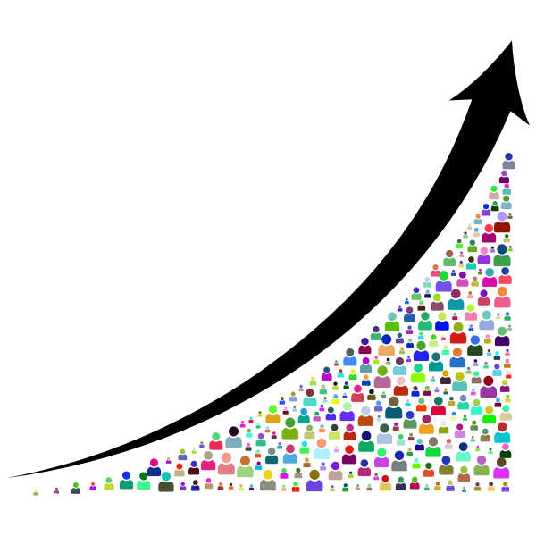
Problem Statement:
Develop an accurate and precise model for forecasting future flight prices
Inform people when the most cost-efficient time to purchase airline tickets is when they travel

Slide 3
Exploratory Data Analysis (EDA)
EDA:
Evaluated variables to examine their impact on pricing.
Identified ‘class of ticket’ and ‘number of stops’ as significant factors.
Key Findings
Higher ticket princess for better classes.
Direct correlation between number of stops and flight duration.
Longer duration and more stops lead to higher costs.
Data Splitting
Divided data into training and testing for modeling.

Slide 4
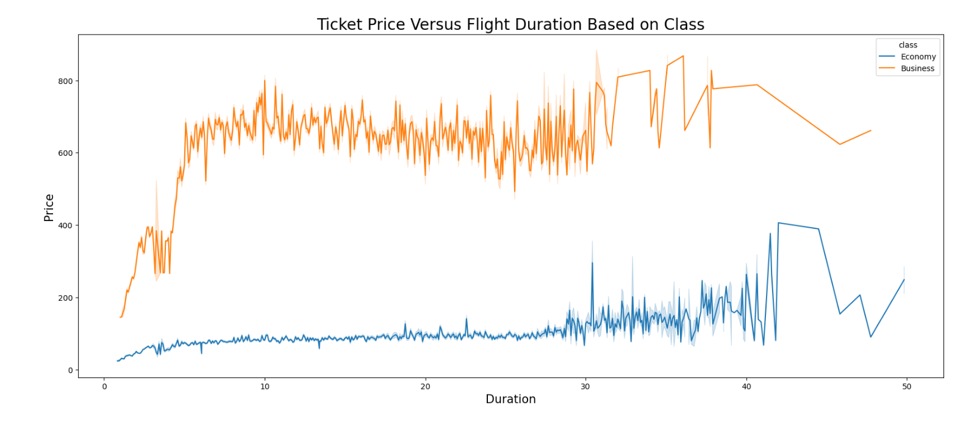
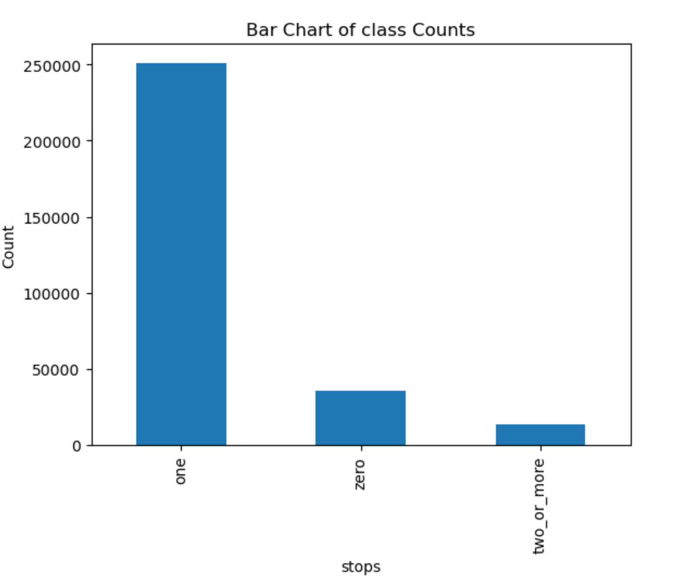
EDA Graphs

Slide 5
Data Preparation and Feature Engineering
Data Preprocessing:
Addressed missing values.
Ensured appropriate data types for each column.
Feature Engineering
Transformed categorical features using one-hot encoding.
Variables Transformation
Scaled numerical features using standardization.
Data Splitting
Split data into training and testing (80-20 ratio) to avoid biases.
Outlier Detection
Identified and filtered outliers using Z-scores.
Model Application
Employed various regression models (LR, Random F, SVR, Lasso).

Slide 6
Methodology and various tools
Infrastructure and Tools :
Jupyter Notebook for dataset and model development.
MacBook Pro 11-core CUP and 14-core GPU to handle large dataset efficiently.
Anaconda used for development and experimentation.
Model Selection
Implemented various models including Linear Regression, Random Forest, Lasso Regression, and SVM.
Each model chosen based on its suitability for different aspect of the analysis.

Slide 7
Findings and Conclusions
Linear Regression :
Predicts flight cost using key features.
MSE: 6608, R-squared: 091 (91% variance explained).
Random Forest
Reduces nose, handles outliers.
R-squared: 0.98 (excellent fit).
SVM
Manages high-dimensional and non-linear data.
R-squared: 0.89 (strong model).
Lasso Regression
Identifies significant features.
R-squared: 0.90 (good fit).
Business Insight
Effective use of feature engineering and scaling techniques improves model accuracy.
Identifying and filtering outliers improve model robustness.
Using multiple regression models provide a comprehensive understanding for airfare prediction.

Slide 8
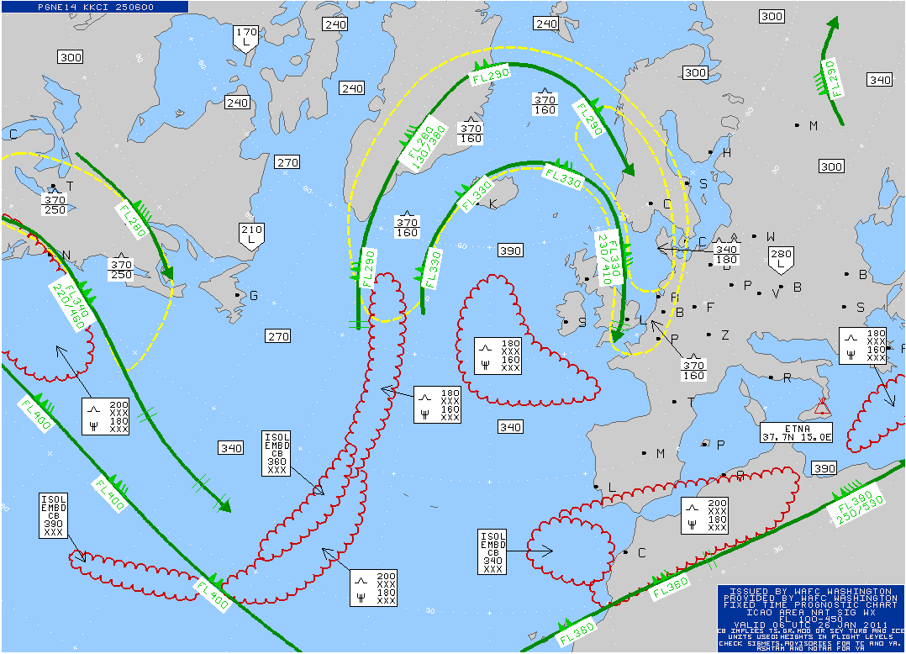

Lessons Learned & Recommendations
Feature Selection and Outlier Handling:
Crucial for improving predictive accuracy in airfare models.
Random Forest model
Stands out for its ability to mitigate noise and overiffiting.
Reinforces the need to choose robust modeling techniques.
Future Model Enhancement
Incorporate variables such as weather conditions, economic indicators, and customer reviews for better prediction and deeper insight.

